Slide 1



Milky Way – Andromeda Dark Matter Halo Velocity Dispersion Profiles
Aidan DeBrae
NASA Space Grant Intern
Mentor: Dr. Peter Behroozi

Slide 2
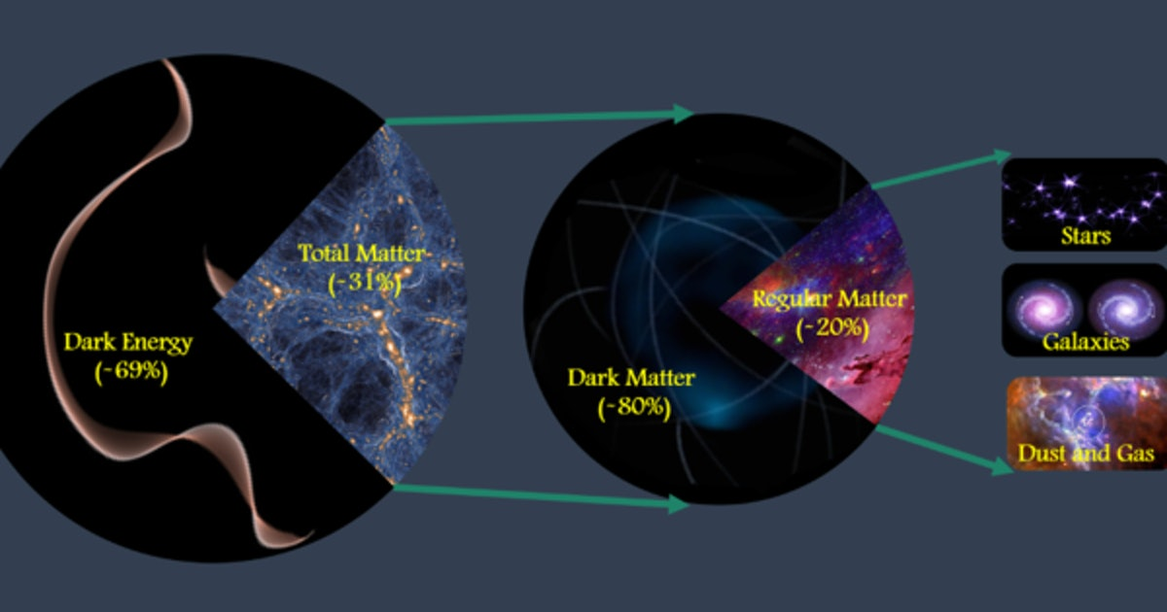
Dark Matter
Dark matter comprises most of the matter in the universe
Dark matter does not absorb or emit light
Dark matter cannot be detected
Dark matter does interact via gravity

Slide 3
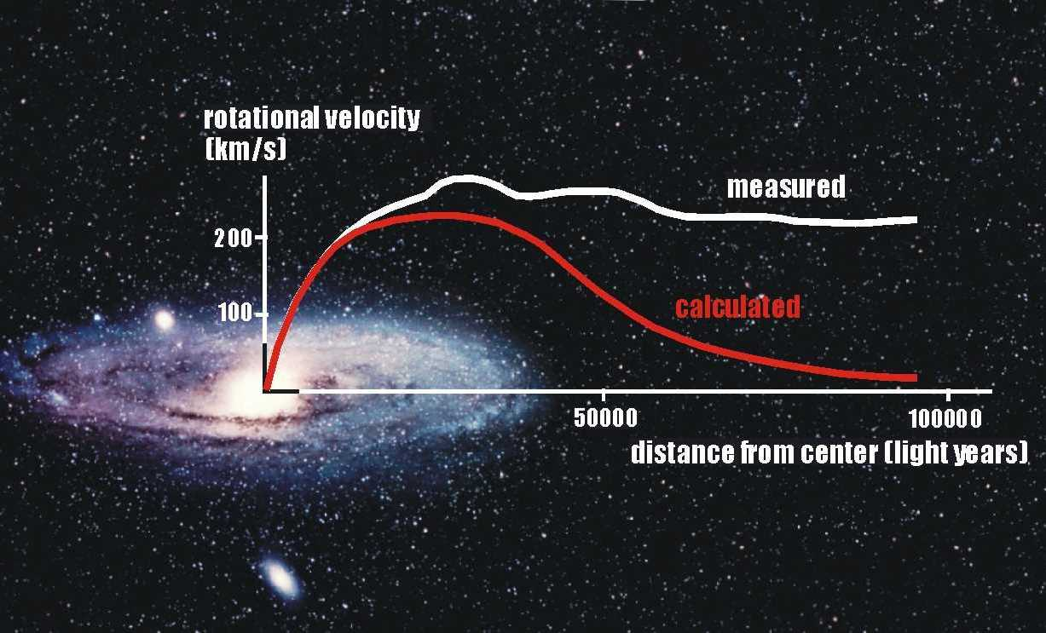
Dark Matter
Credit: Queens Uni.
The rotation curves of galaxies indicate the presence of dark matter

Slide 4
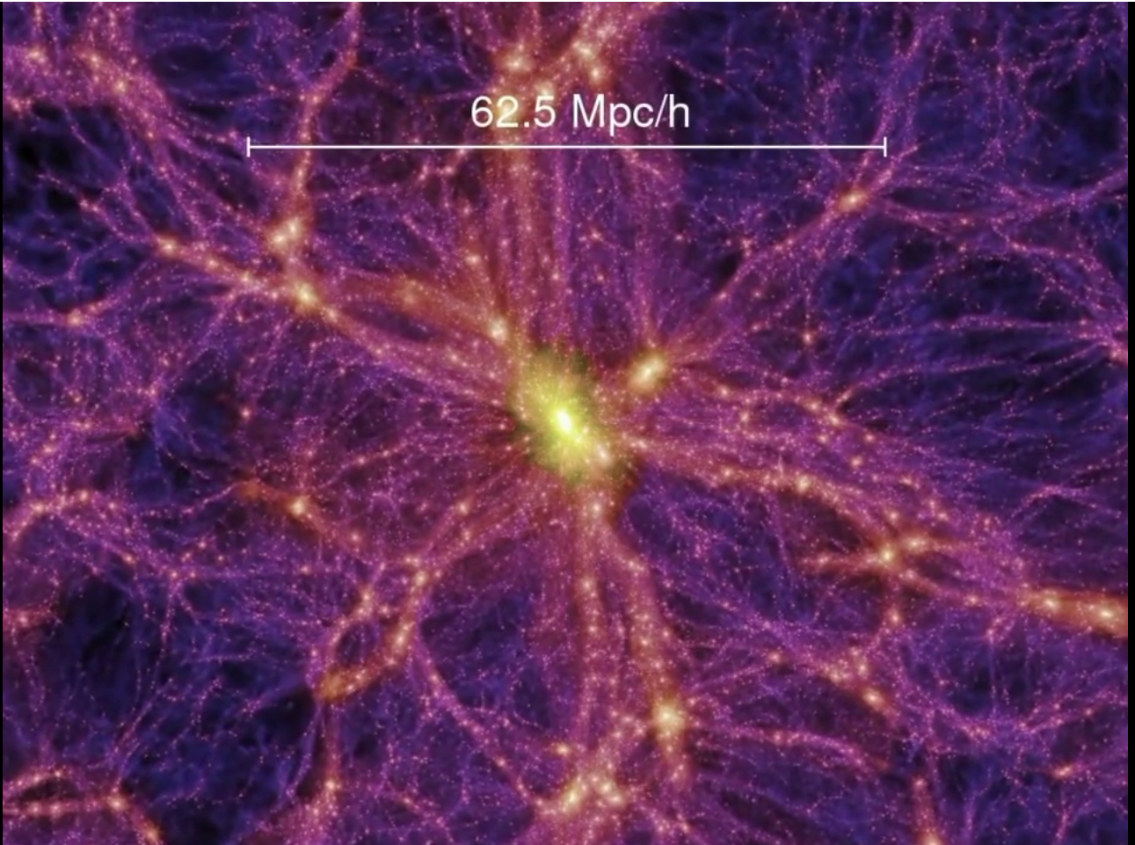
Dark Matter Halos
Dark matter density structure
Dark matter halos envelope galaxies and clusters
The properties of the dark matter halo could provide insight about the gravitational influence it has over the galaxy
Credit: Springel et al. (Virgo Consortium) & Max-Planck Institute for Astrophysics

Slide 5
Velocity Dispersion
The virial mass theorem is applied to dark matter halos to estimate their mass
We can estimate the mass of a halo and consequently the gravitational potential after constructing the velocity dispersion profile
The velocity dispersion profile of a dark matter halo is of great interest for direct detection experiments

Slide 6
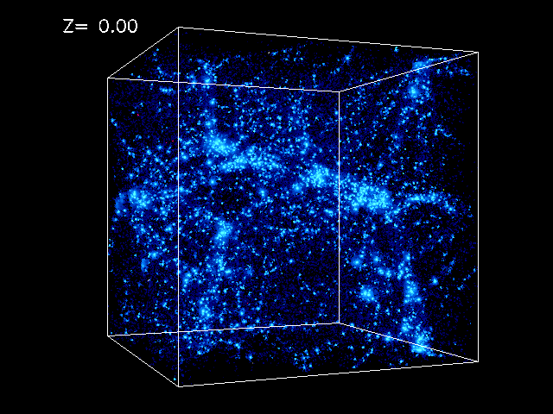
Cosmological Simulations
A simulation of the universe is constructed based off our current knowledge and predictions
We can investigate the properties of dark matter halos within these simulations

Slide 7
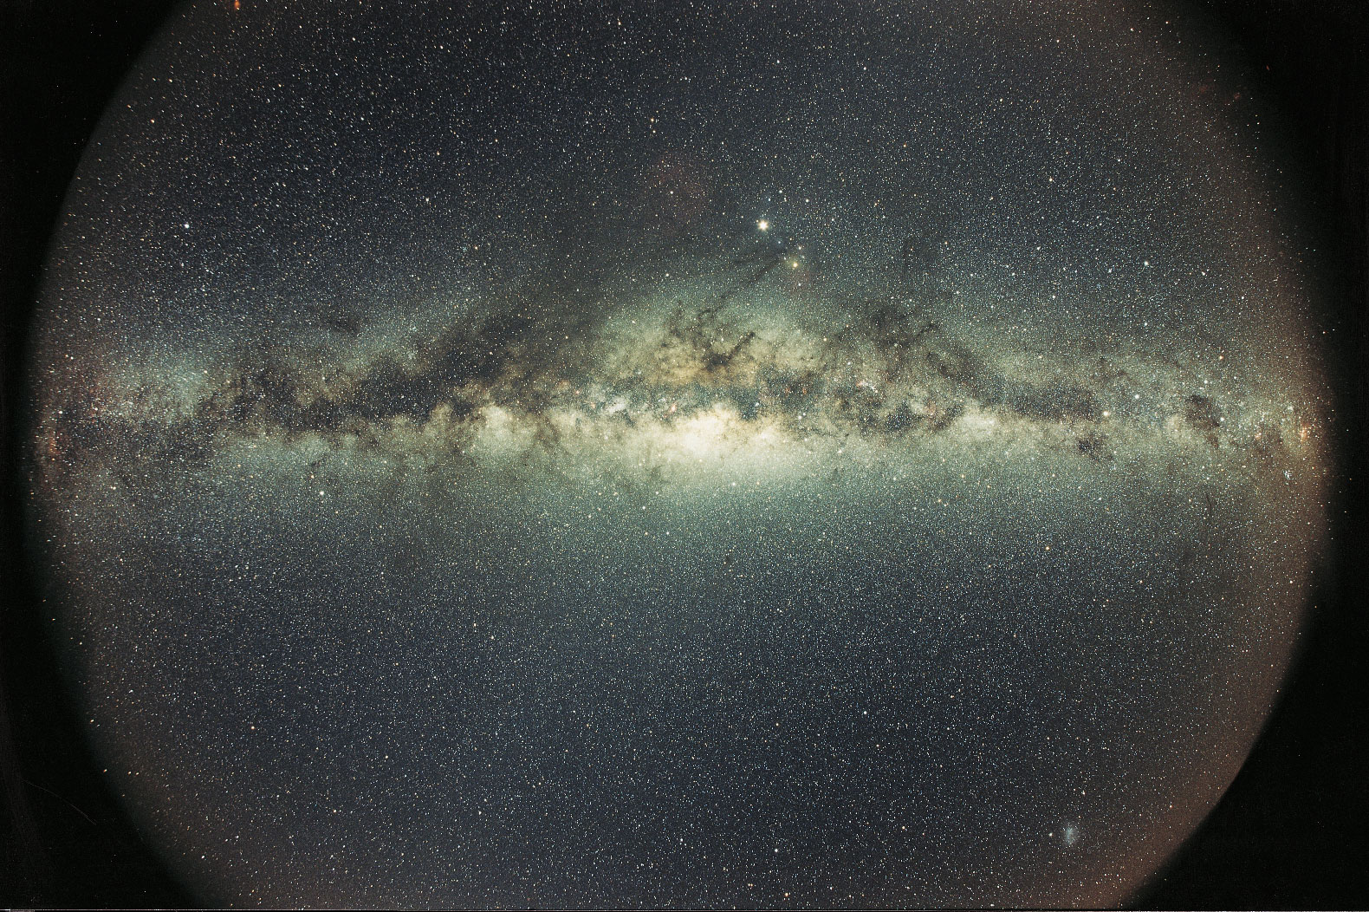
MW-Andromeda Dark Matter Halos
We find dark matter halos in the simulation that are consistent with the dark matter halos that should exist around both galaxies
The criteria for choosing the halos is mass, distance, and velocity (radial & tangential) like the Milky way and Andromeda
Credit: Dirk Hoppe & Encyclopædia Britannica

Slide 8
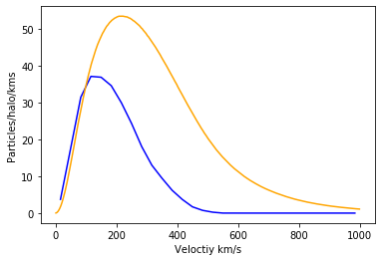
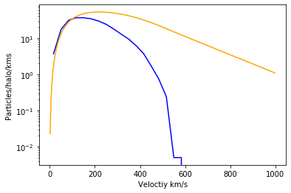
Velocity Dispersion of Milky Way & Andromeda
Once we’ve found dark matter halos that satisfy our criteria, we can find all the neighboring dark matter particles and construct a velocity dispersion profile

Slide 9
Results
The preliminary velocity dispersion profile constructed in our analysis indicates that dark matter particles move slower in the MW-Andromeda system
If the particles move slower in the presence of Andromeda, this means it will be harder to detect dark matter particles in direct detection experiments

Slide 10
Thank you
Dr. Peter Behroozi
University of Arizona Astronomy Department
NASA & The Arizona Space Grant Consortium

